Slide 2
What Is a Depletion-Load NMOS Inverter?
This inverter uses two NMOS transistors:
Load transistor (depletion-type NMOS): Always ON (negative threshold voltage), acts as a "pull-up."
Driver transistor (enhancement-type NMOS): Switches ON when input is HIGH, acts as a "pull-down."
This topology was foundational before CMOS; it’s still used for analysis and education on complementary logic design, noise margins, and sizing for power/performance tradeoffs.

Slide 3
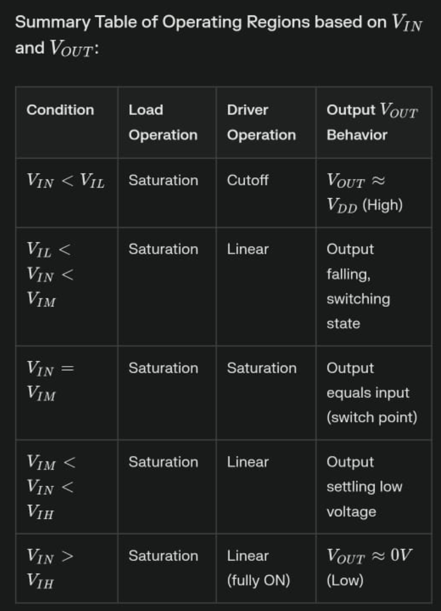
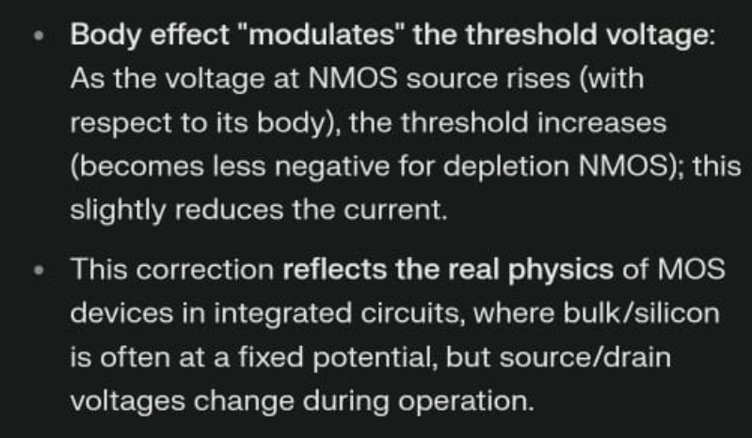

Slide 4
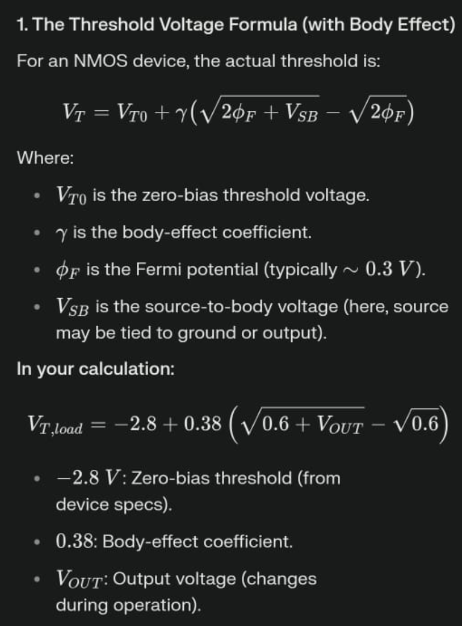
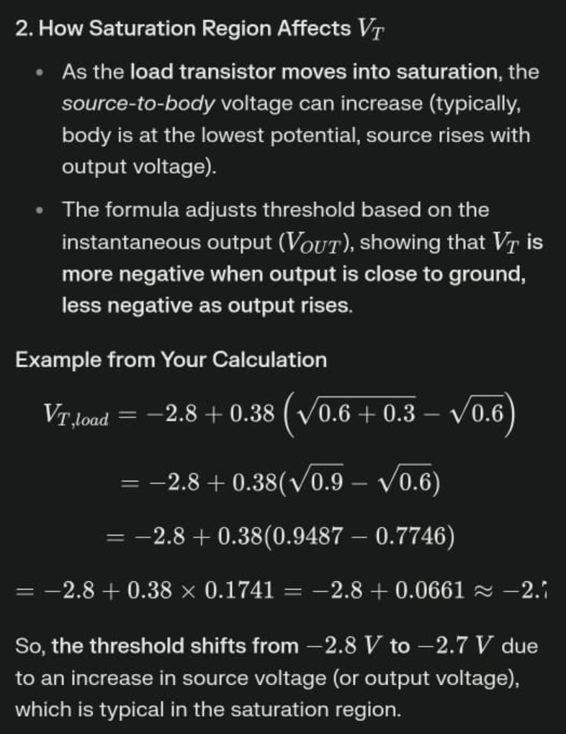

Slide 5
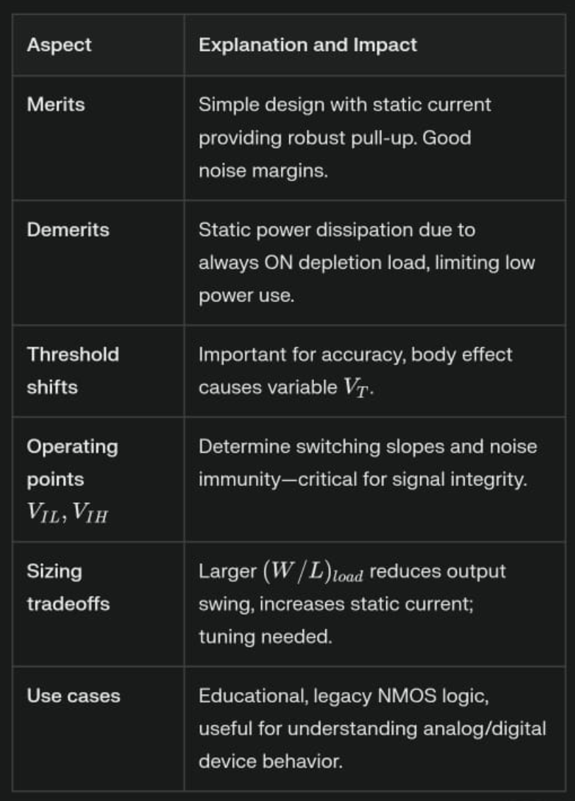
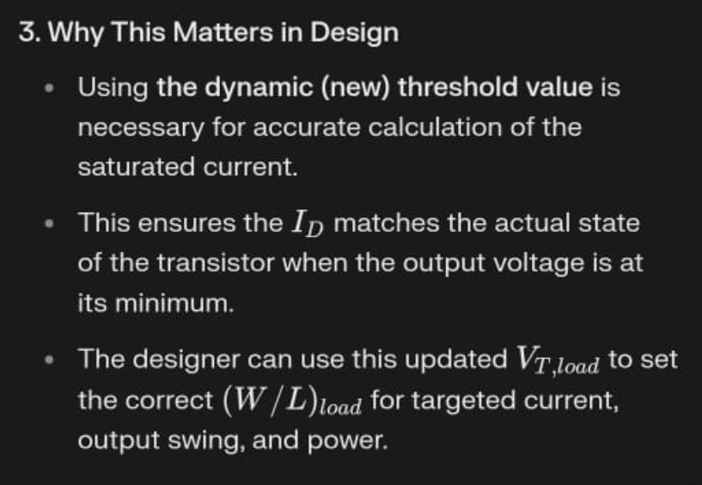

Slide 6
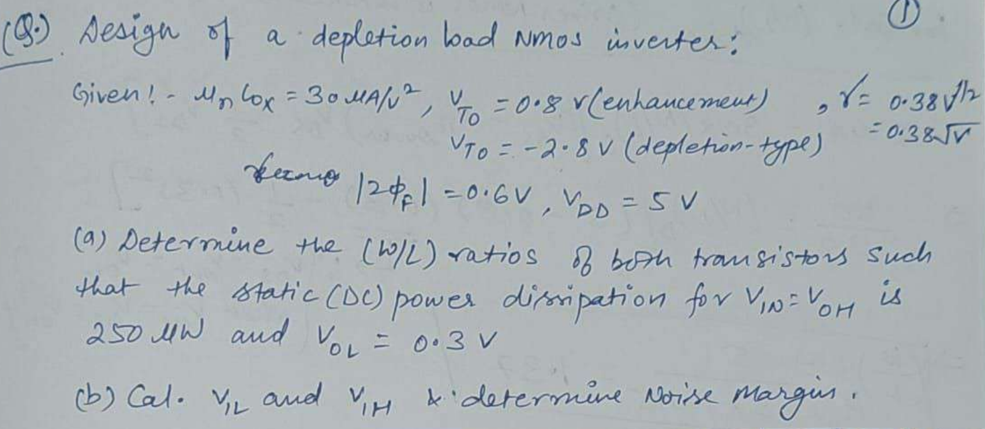
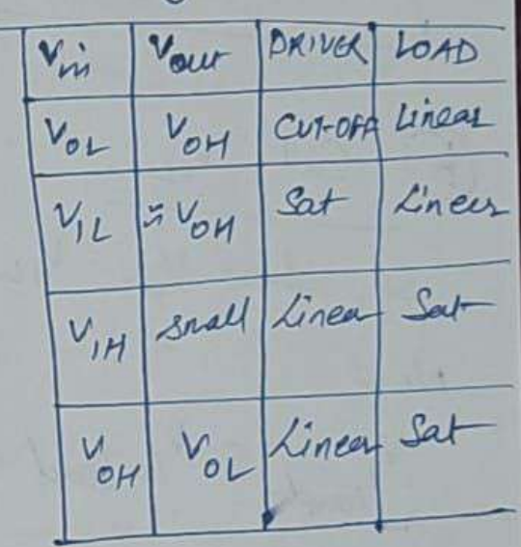

Slide 7
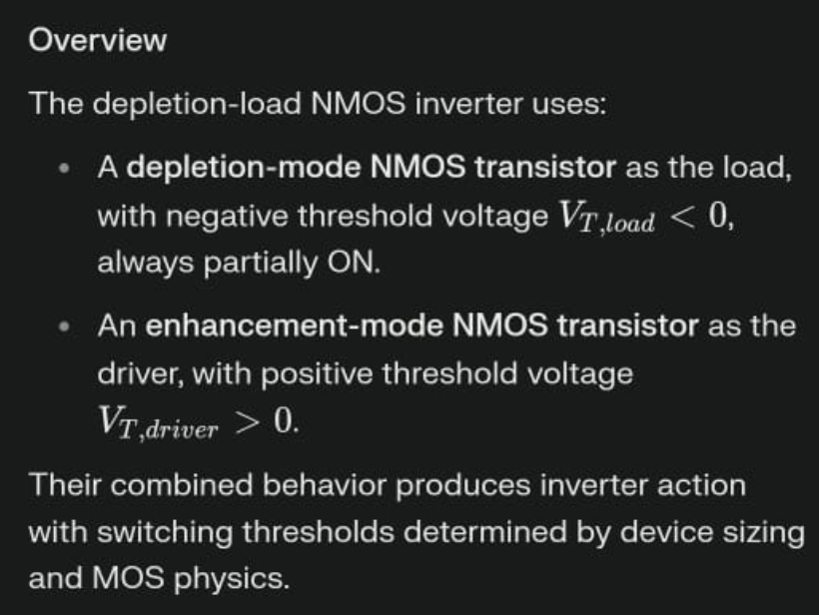

Slide 8
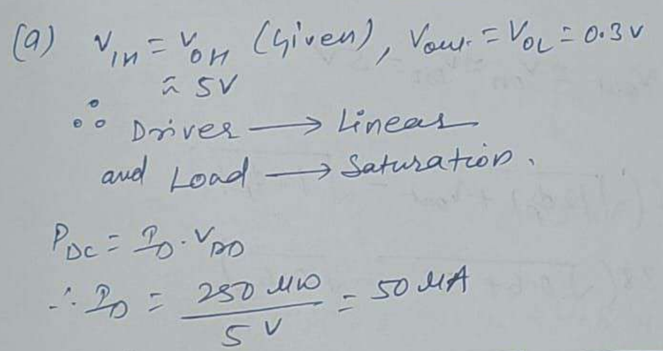
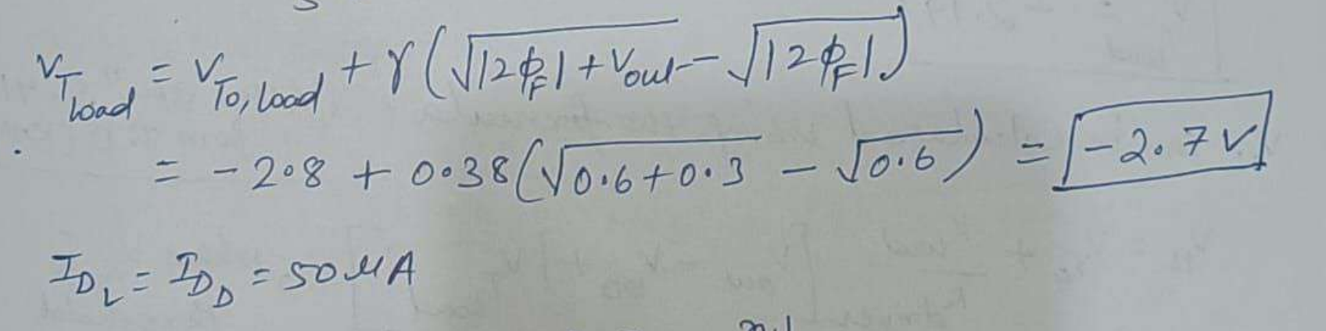

Slide 9
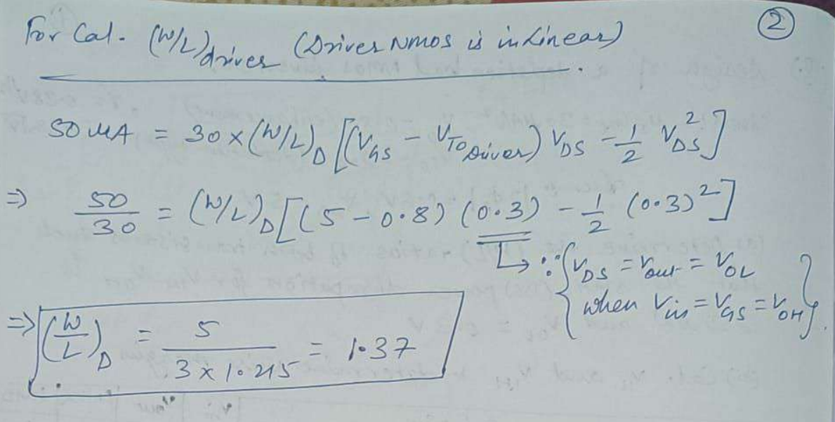

Slide 10
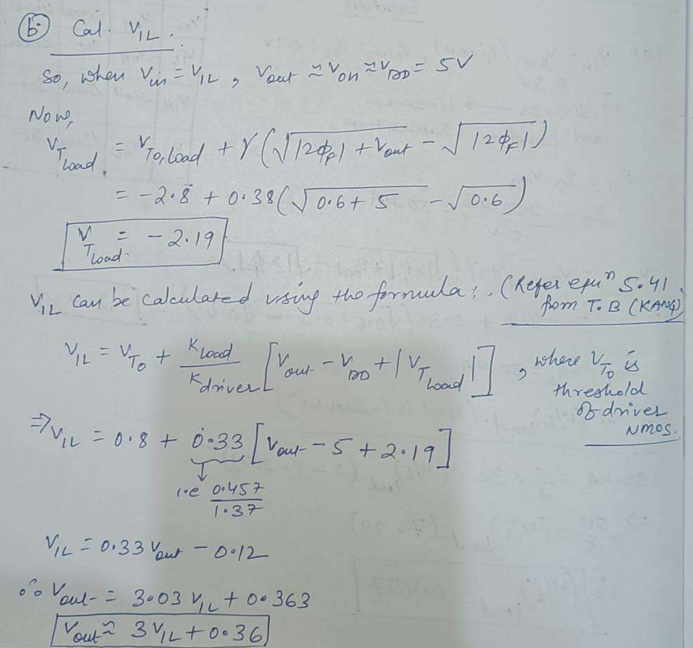

Slide 11
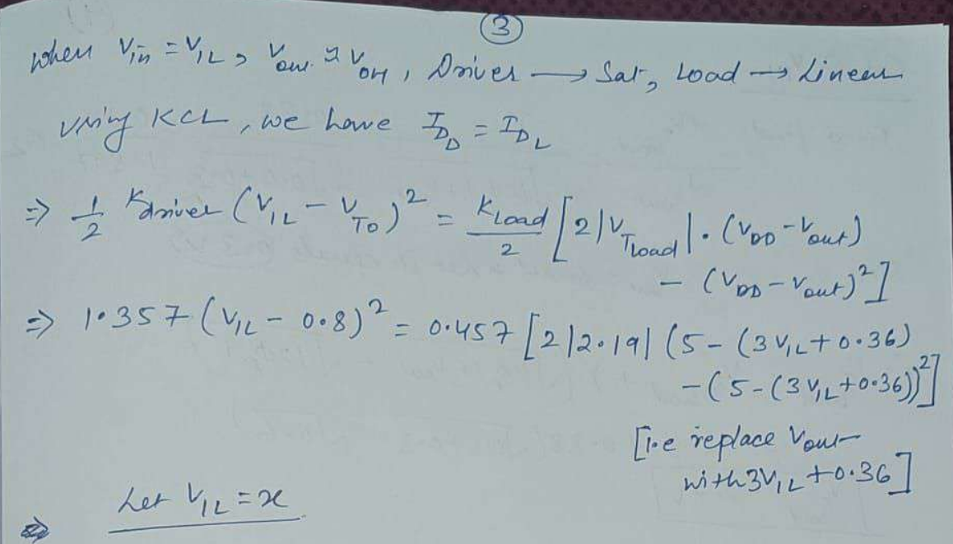

Slide 12
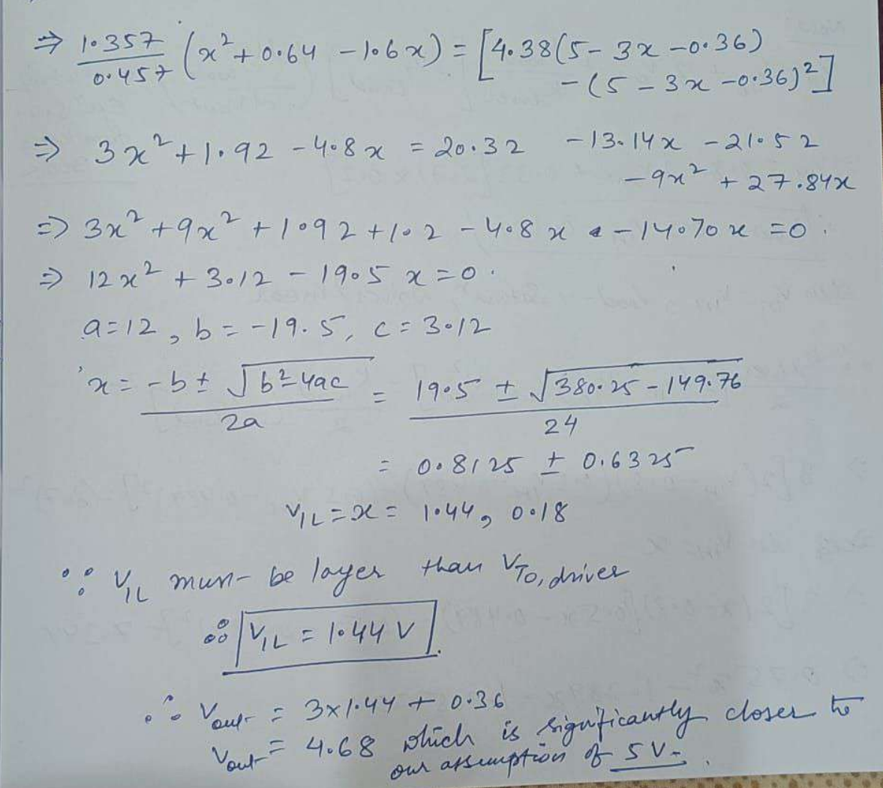

Slide 13
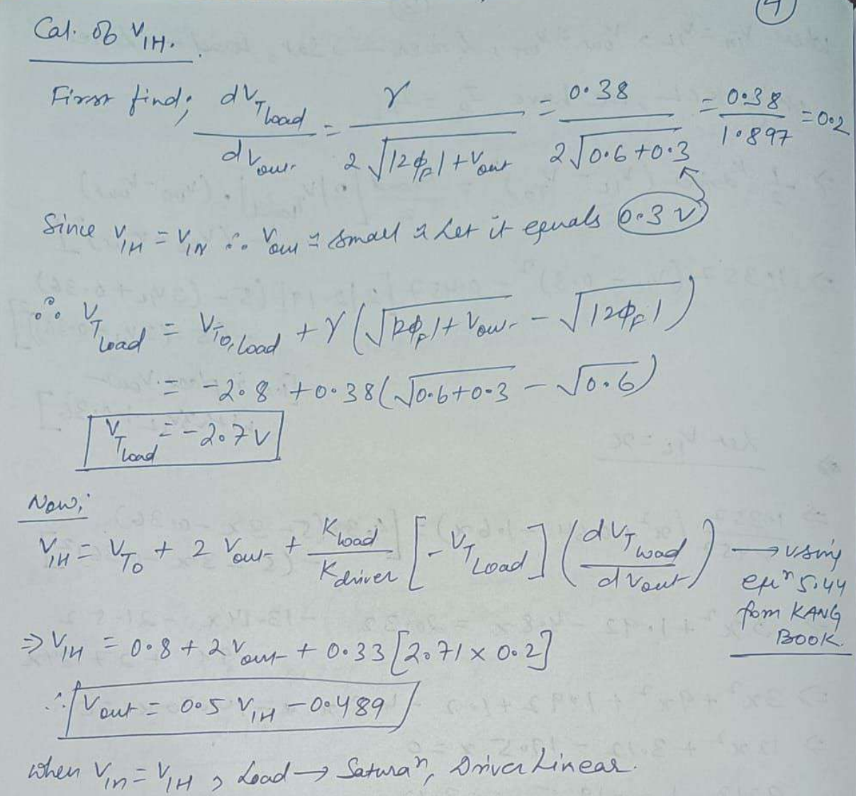

Slide 14
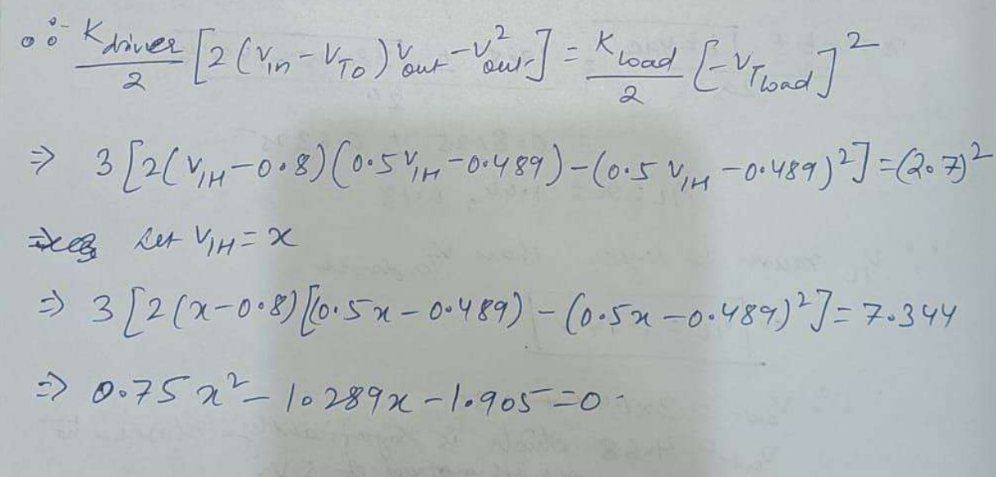

Slide 15
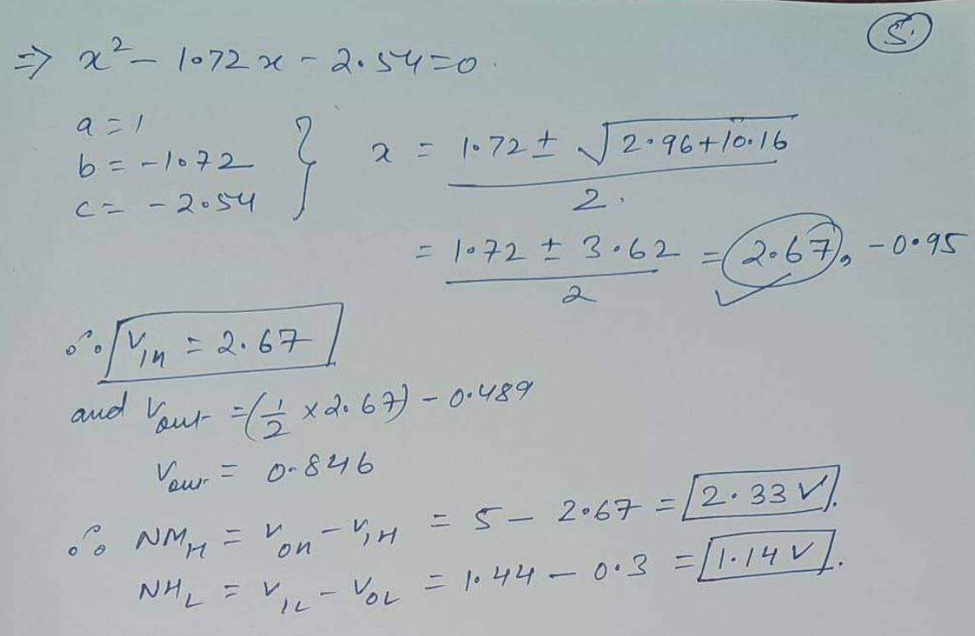

Slide 16
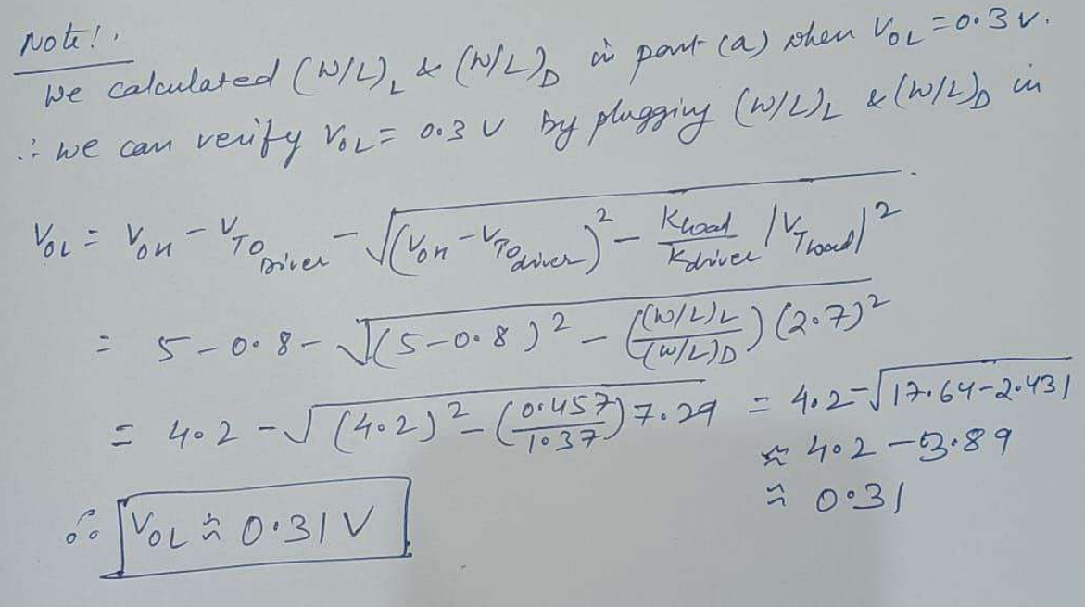

Slide 17
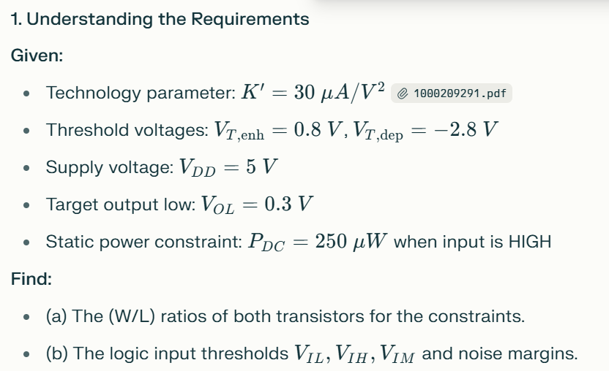

Slide 18
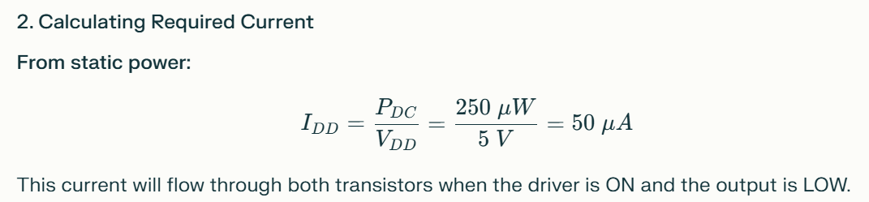

Slide 19
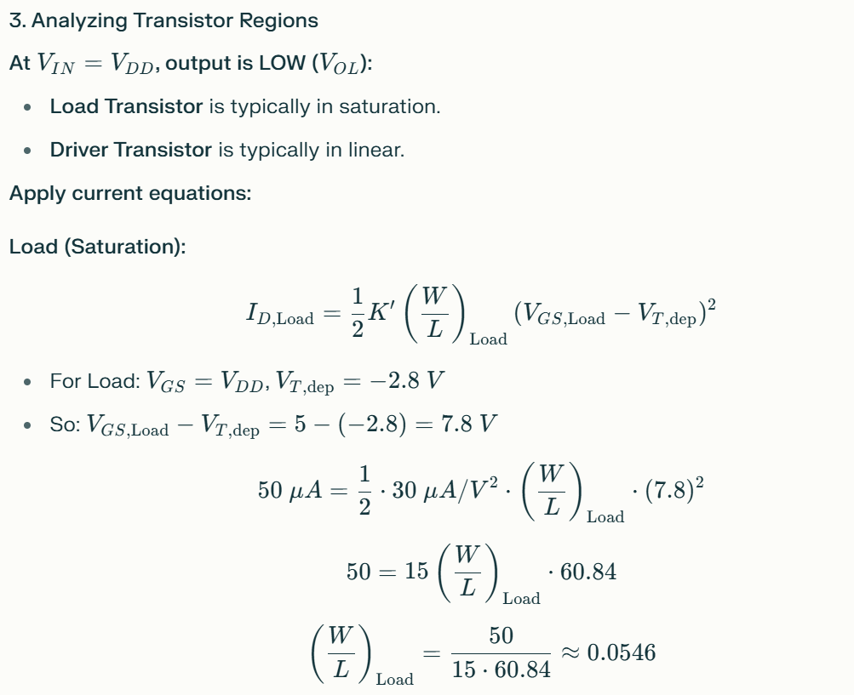

Slide 20
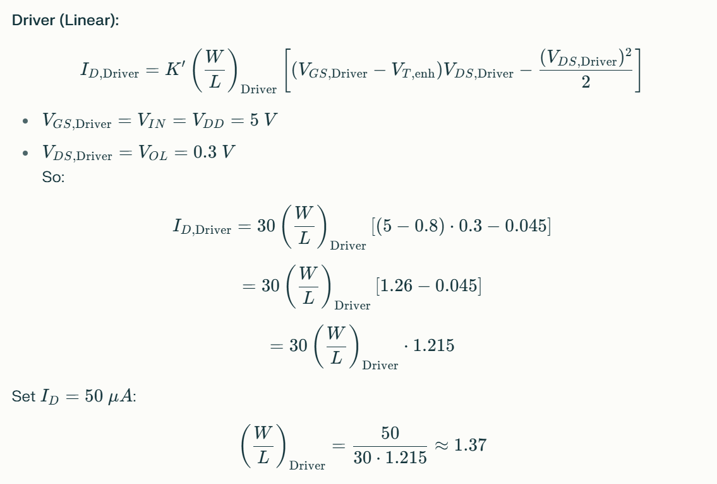

Slide 21
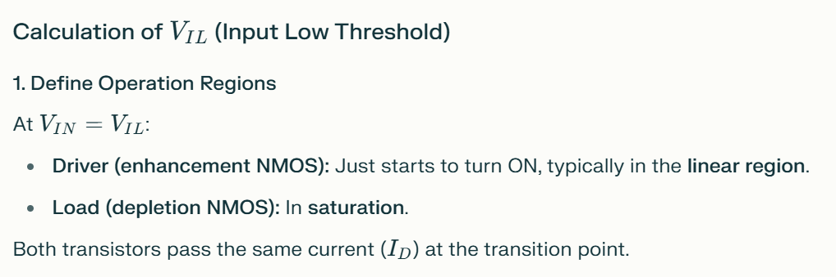

Slide 22
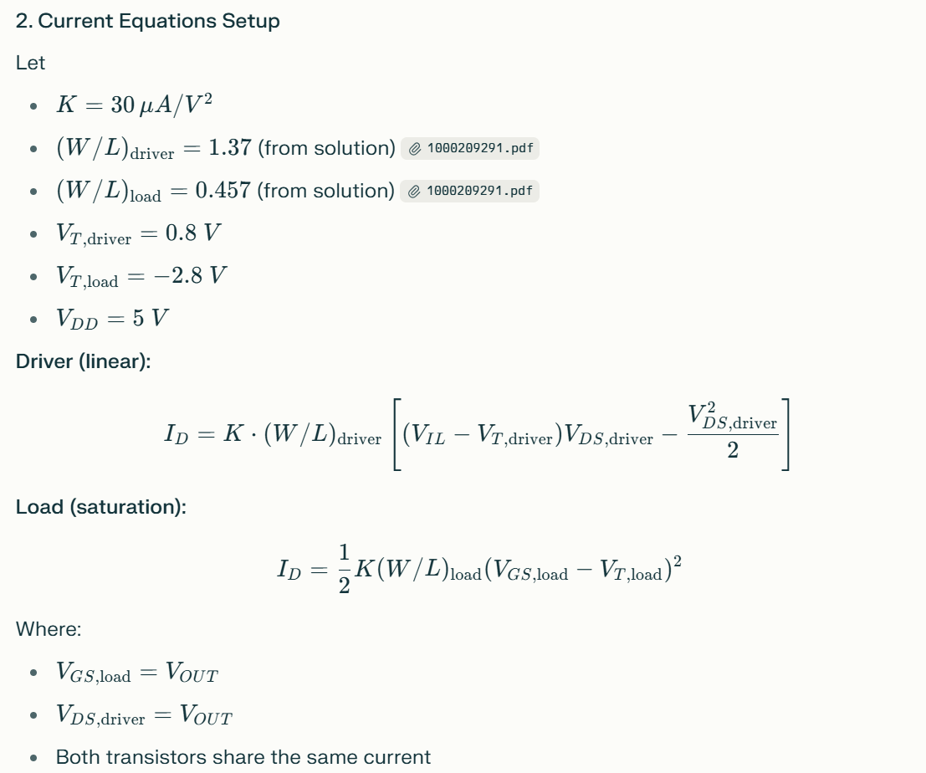

Slide 23
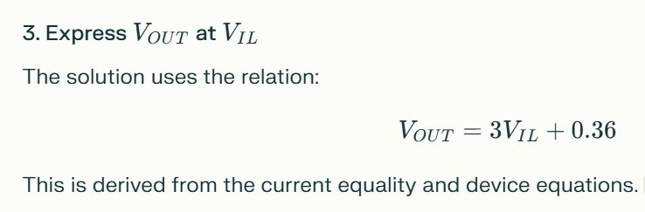

Slide 24
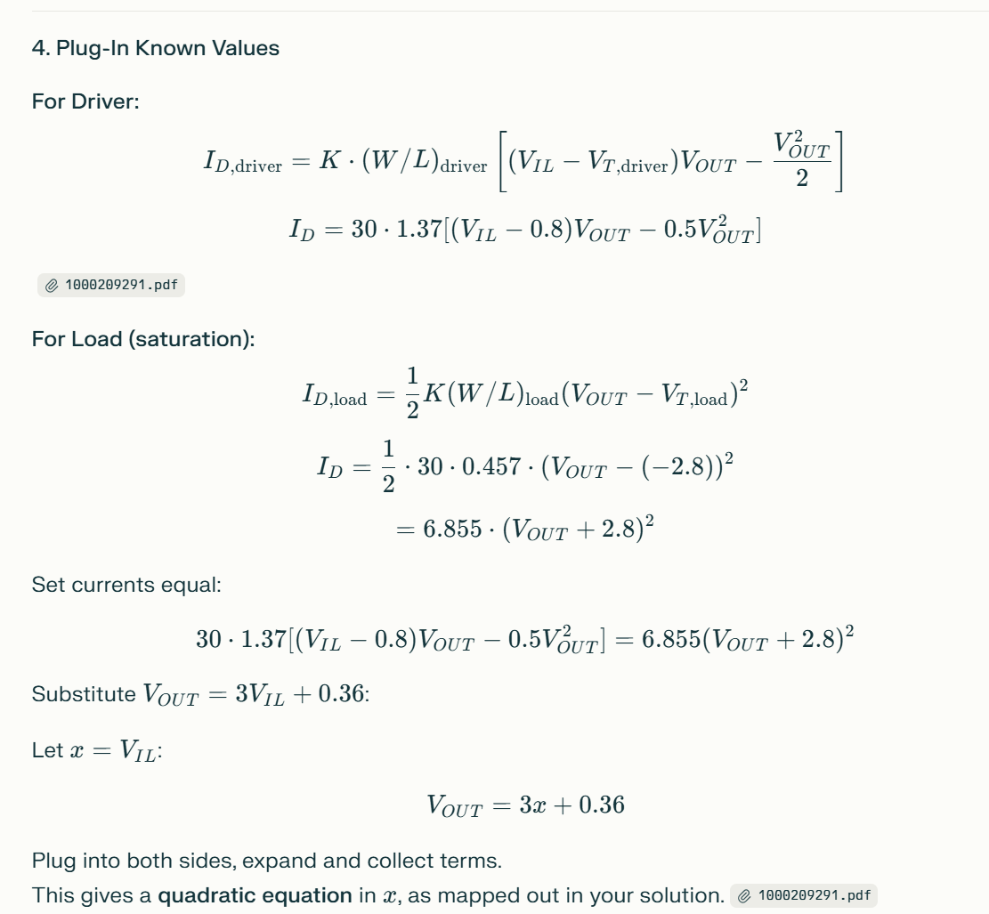

Slide 25
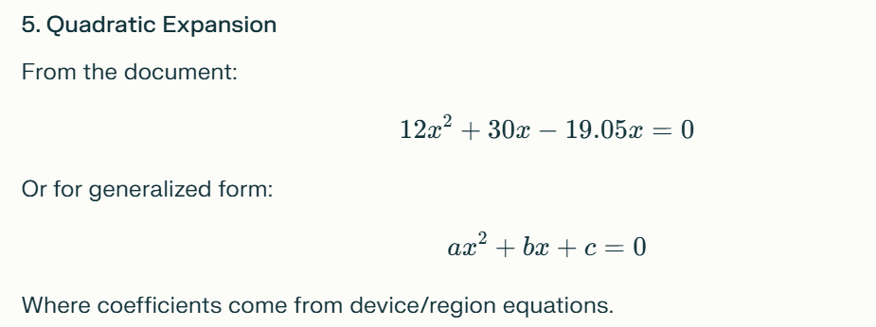
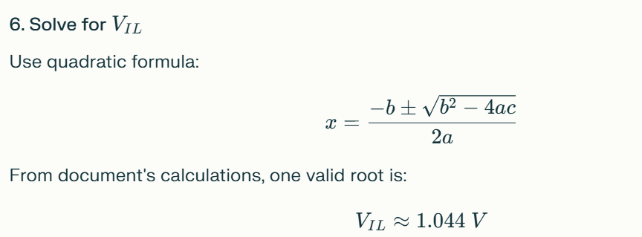

Slide 26
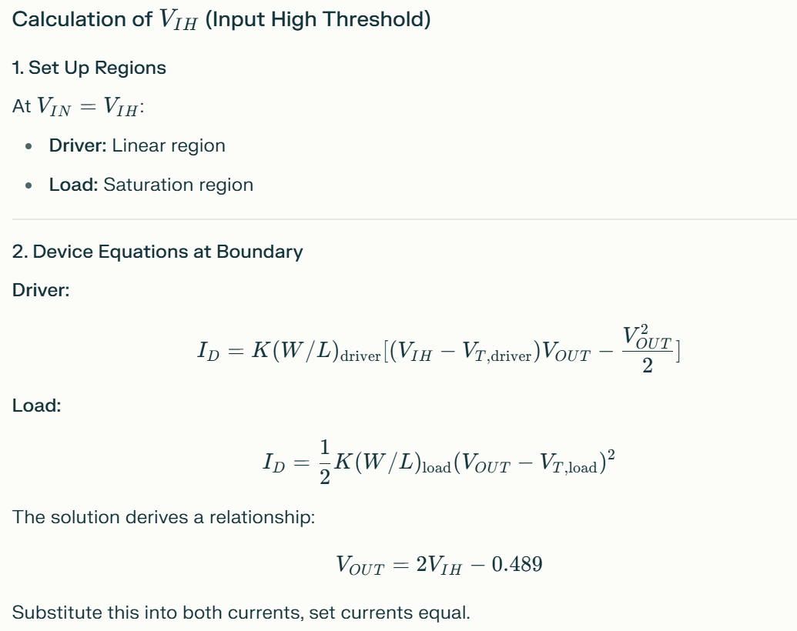

Slide 27
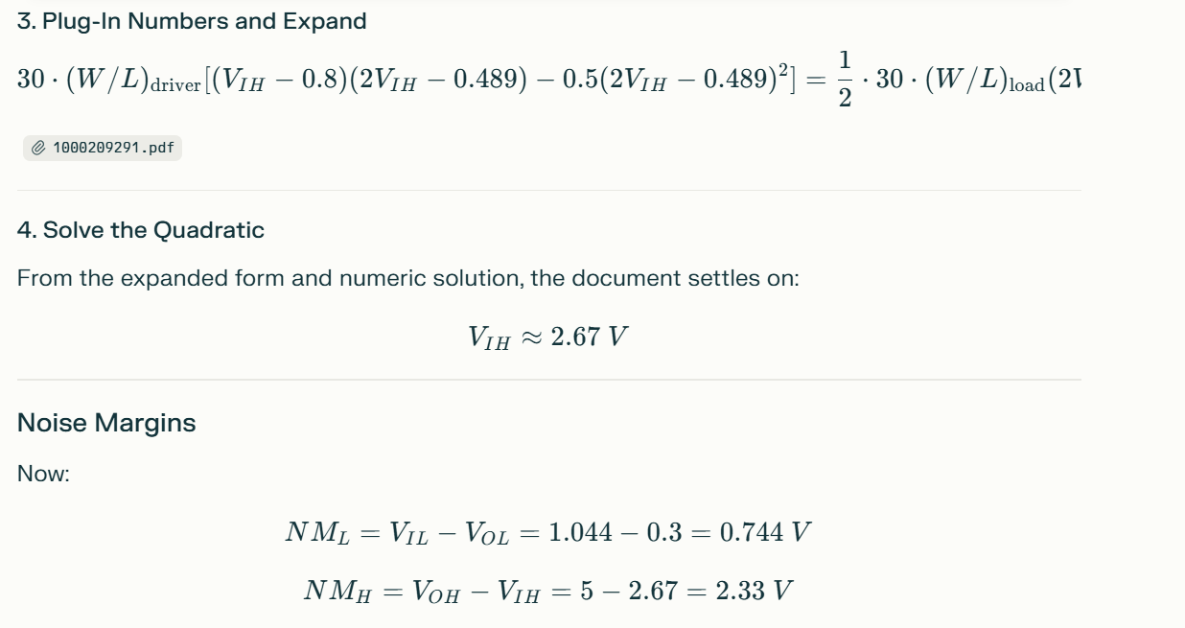

Slide 28
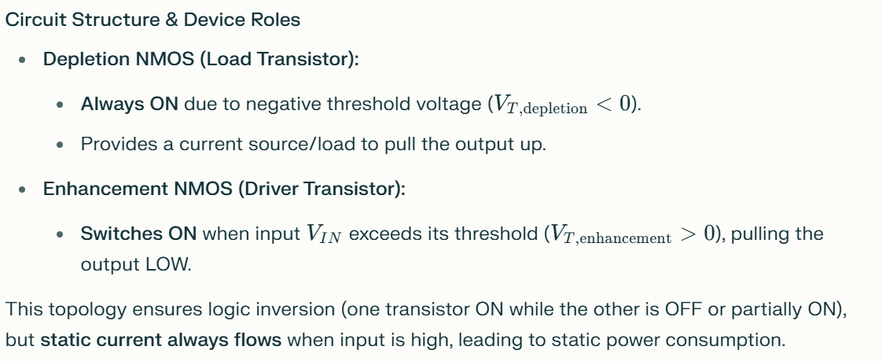
Depletion-Load NMOS Inverter: Comprehensive Design Perspective
The depletion-load NMOS inverter was a key early building block in digital VLSI before the widespread adoption of CMOS. Understanding its sizing, operation regions, and noise margin estimation is foundational for students of VLSI.

Slide 29
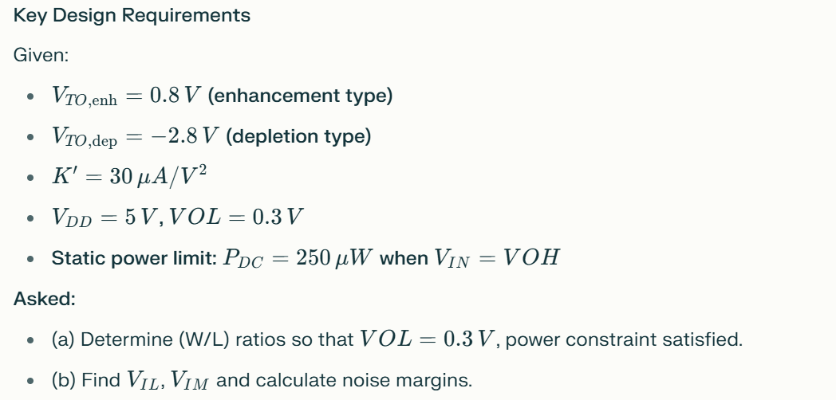
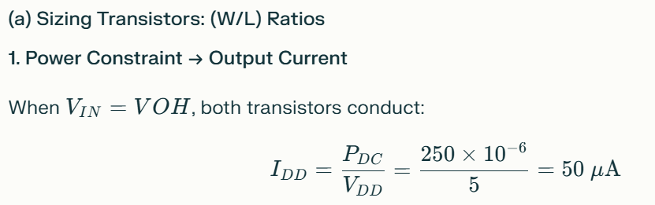

Slide 30
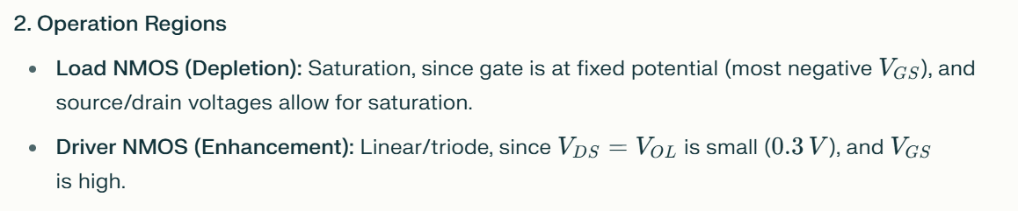
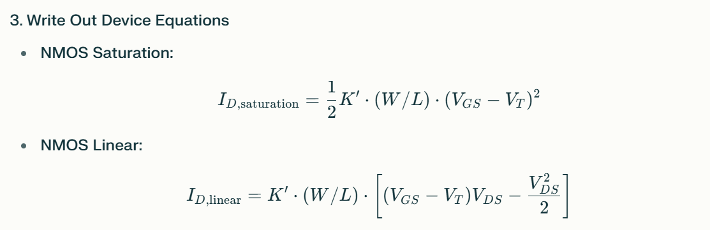

Slide 31
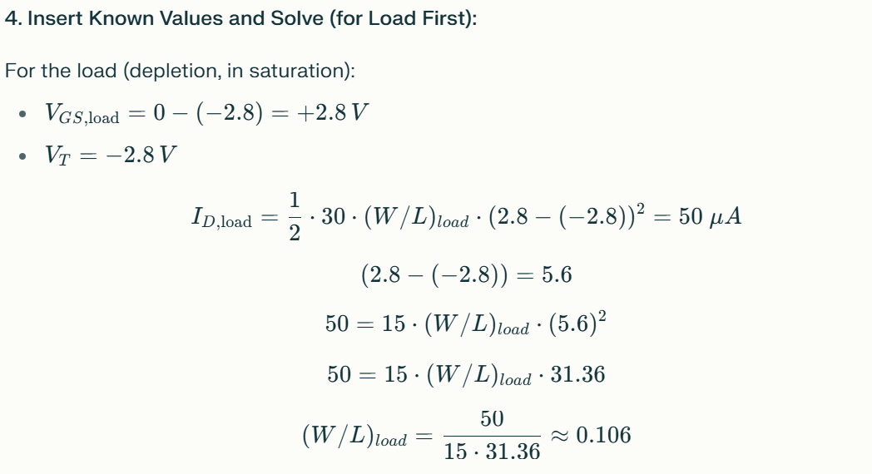
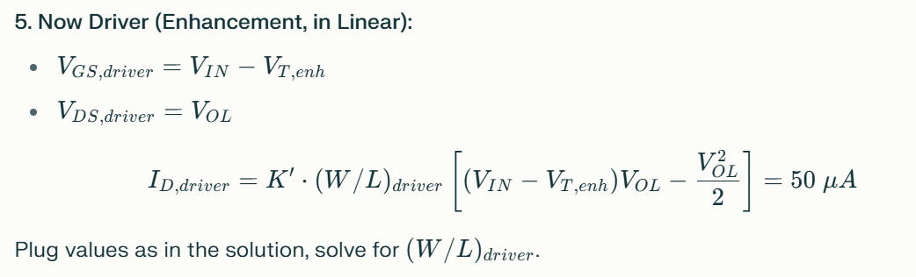

Slide 32
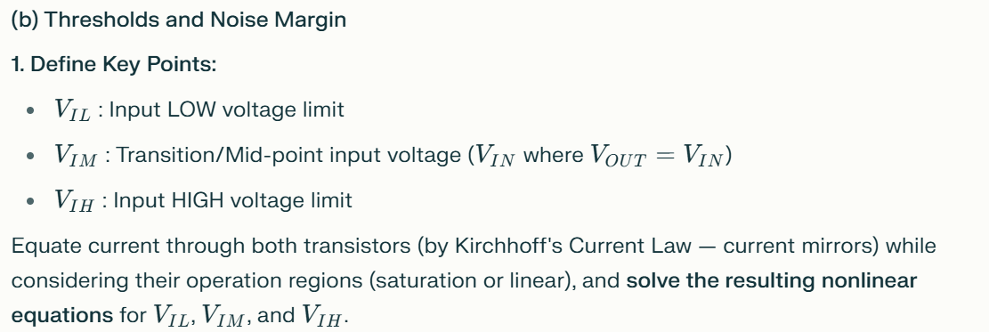
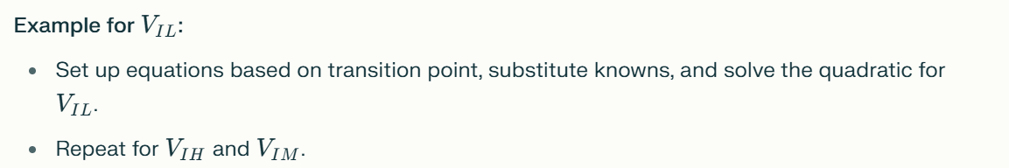

Slide 33
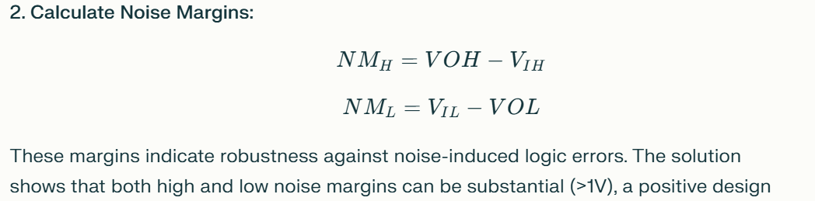
Practical Design Insights
(W/L) Ratio drives both speed (capacitance), noise margin, and power.
The depletion load allows for a better output swing and higher noise margins compared to resistive or enhancement-only loads.
The sizing procedure is iterative: set one parameter (e.g., VOL, power), compute current and region, solve for ratios.
Final device equations incorporate all real-world effects (quadratics, nonlinearities). The manual equation setup and solution reinforce deep understanding of MOSFET operation in logic design.

